Slide 1



A More Proactive Approach to Aging in Place

Slide 2
Table of contents
1
Executive Overview | p. 3
Extending Care Beyond the Visit
Outcomes We Help Support
2
The Lifeguard Service Model | p. 6
The Lifeguard Mode
Wellness Reports
The Lifeguard Alert Center (LAC)
3
Business Outcomes | p. 10
Real Worl Results
Why Partners Choose Lifeguard

Slide 3
Executive Overview

Slide 4
Extending Care Beyond the Visit
CORE TECHNOLOGY
Helping Identify Risks Earlier and Support Better Outcomes at Home
Many changes that lead to hospitalizations, falls, emergency department visits, or care breakdowns begin gradually over days or weeks.
Through the combination of Griswold's caregiving services and Lifeguard's home monitoring, care teams gain visibility into changes that may otherwise go unnoticed between visits.

Slide 5
Outcomes We Help Support
CORE TECHNOLOGY
Earlier Identification of Potential Health Concerns
Changes in mobility, sleep, nutrition, hygiene, and daily routines can indicate emerging health issues before a crisis occurs.
Faster Intervention When Something Changes
Prolonged inactivity alerts and wellness insights help care teams respond sooner and determine whether additional support is needed.
Better Continuity of Care
Objective activity data provides additional context to family members, care managers, and healthcare providers.
More Time Safely at Home
By identifying changes earlier, clients can receive the right level of support before issues escalate.

Slide 6
The Lifeguard Service Model

Slide 7
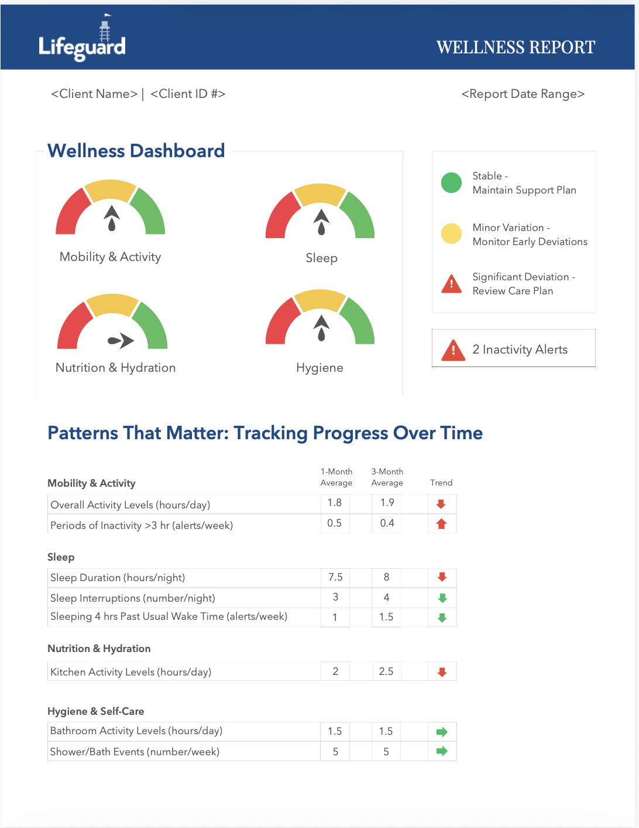
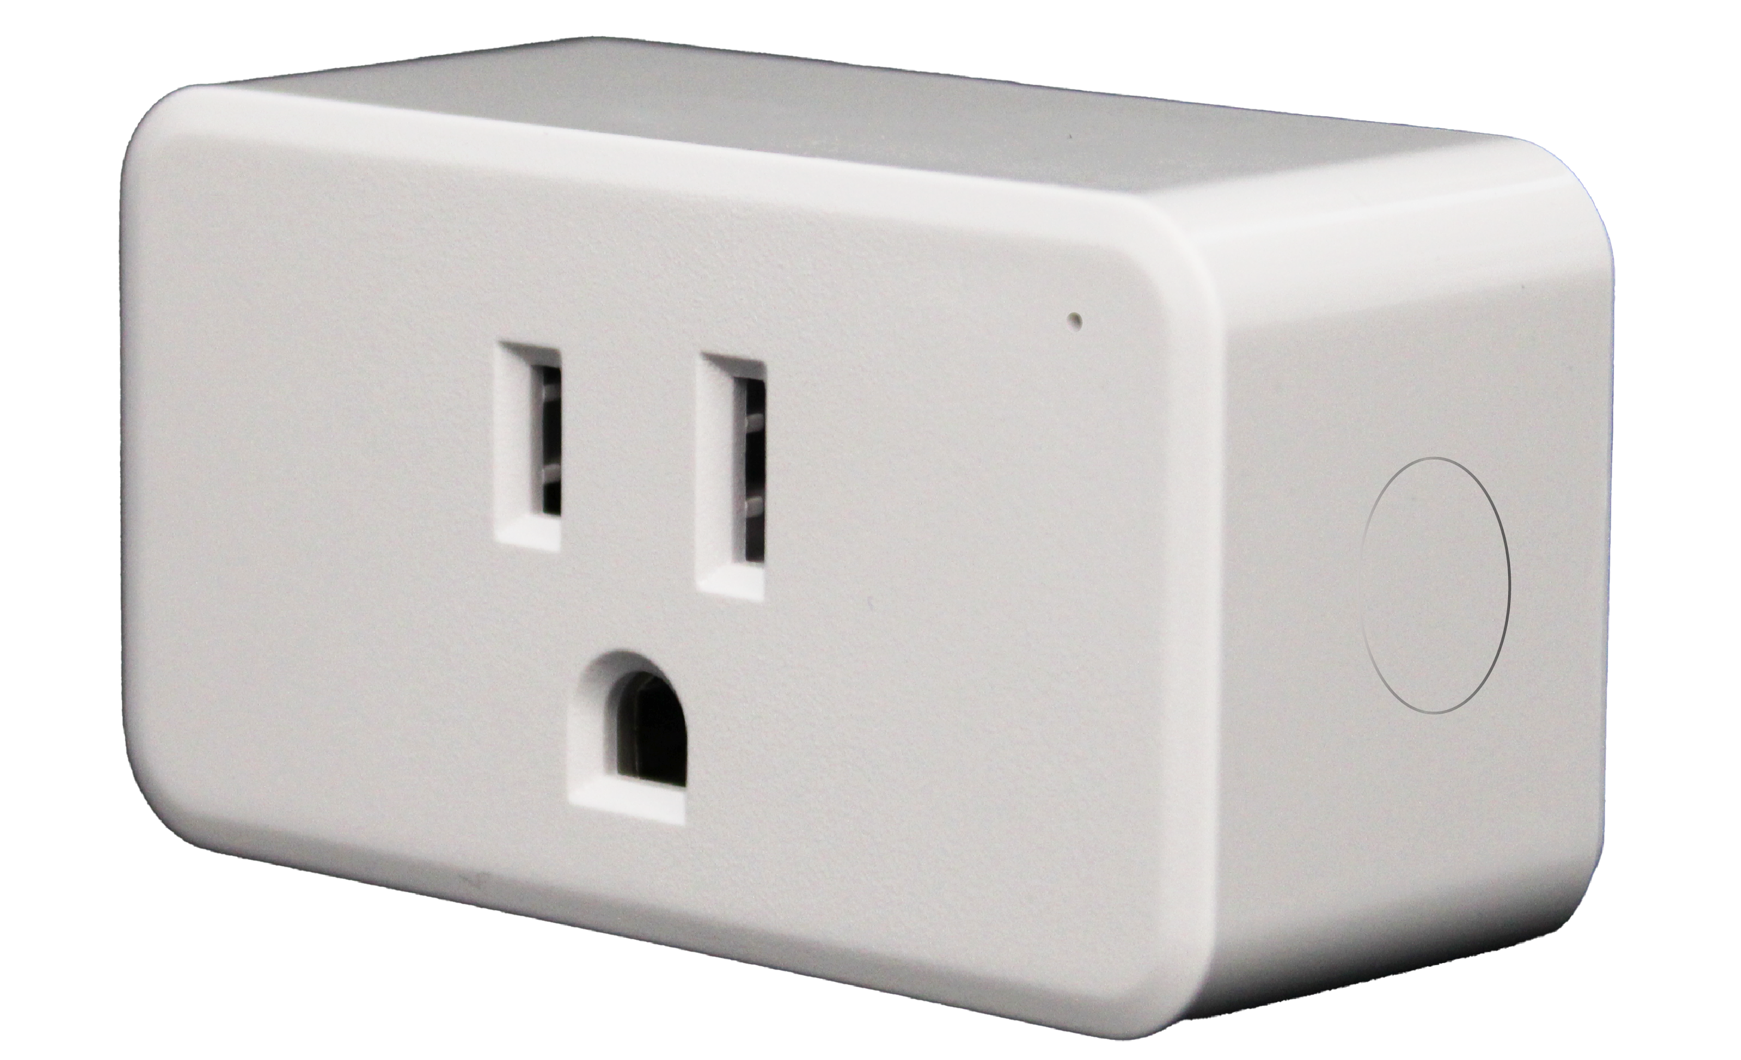

The Lifeguard Model
THE LIFEGUARD SERVICE MODEL
Lifeguard
Platform
Clinical & Monitoring Layer
• Licensed Nurses review data
and prepare Wellness Reports
• Lifeguard Alert Center (24/7)
monitors alerts and
escalates
when needed
Lifeguard
Platform
Clinical & Monitoring Layer
• Licensed Nurses review data
and prepare Wellness Reports
• Lifeguard Alert Center (365 monitoring)
monitors alerts and
escalates
when needed
A technology-enabled care service connecting clients, care agencies, and families
Home Care
Agency (Customer)
Actionable insights
delivered to care teams
Technology Layer
• Captures activity, sleep,
and routine patterns
• Detects meaningful
changes over time
Lifeguard turns passive in-home data into clinical insight and real-time response — without adding work for care teams.
The Home (Client)
Discreet WiFi Motion
Technology
Better care planning, stronger family communication

Slide 8
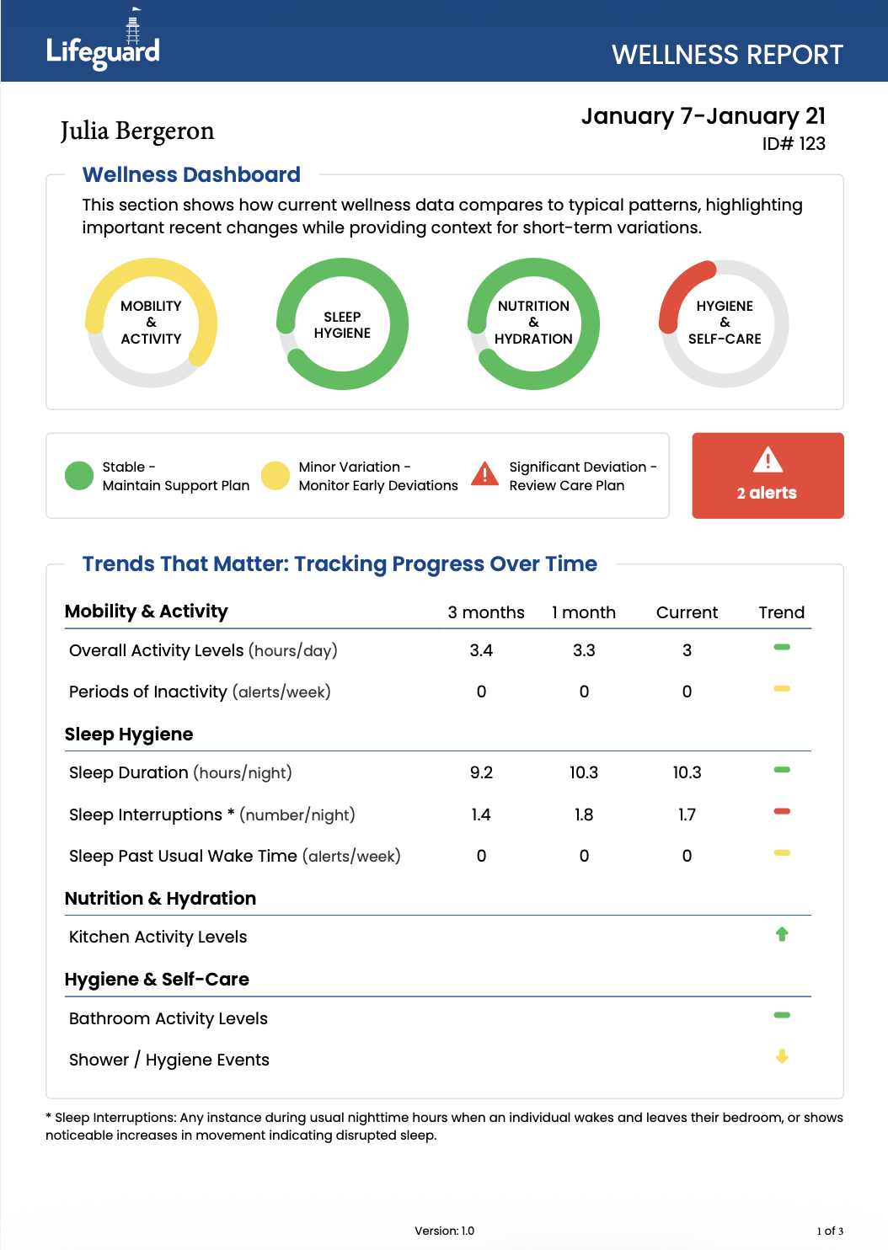



Wellness Reports
THE LIFEGUARD SERVICE MODEL
Lifeguard Wellness Reports provide a simple, objective view of how a client's routines and activity patterns are changing over time.
Using continuous monitoring data, reports highlight trends related to mobility, sleep, nutrition, hygiene, and overall activity levels. This additional layer of insight can help identify meaningful changes that may warrant further assessment or increased support.
Activity Patterns
Sleep Trends
Hygiene
Nutrition
& Hydration
Long-Term Trends

Slide 9
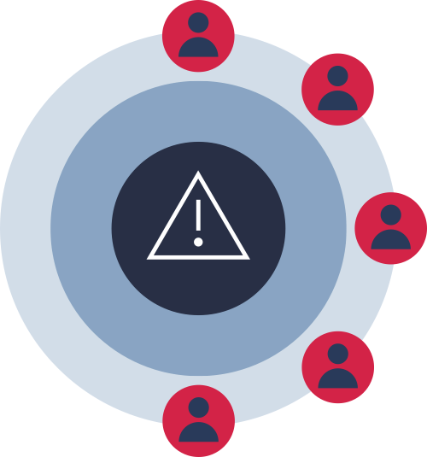




The Lifeguard Alert Center (LAC)
THE LIFEGUARD SERVICE MODEL
The Lifeguard Alert Center provides 365 monitoring, an additional layer of oversight between caregiver visits.
When Lifeguard detects a prolonged period of inactivity, trained monitoring agents initiate a safety check based on the client's personalized care plan.
24/7 Oversight
EMS Dispatch
Escalation Protocols
Rise & Shine
Prolonged Inactivity

Slide 10
Business Outcomes

Slide 11
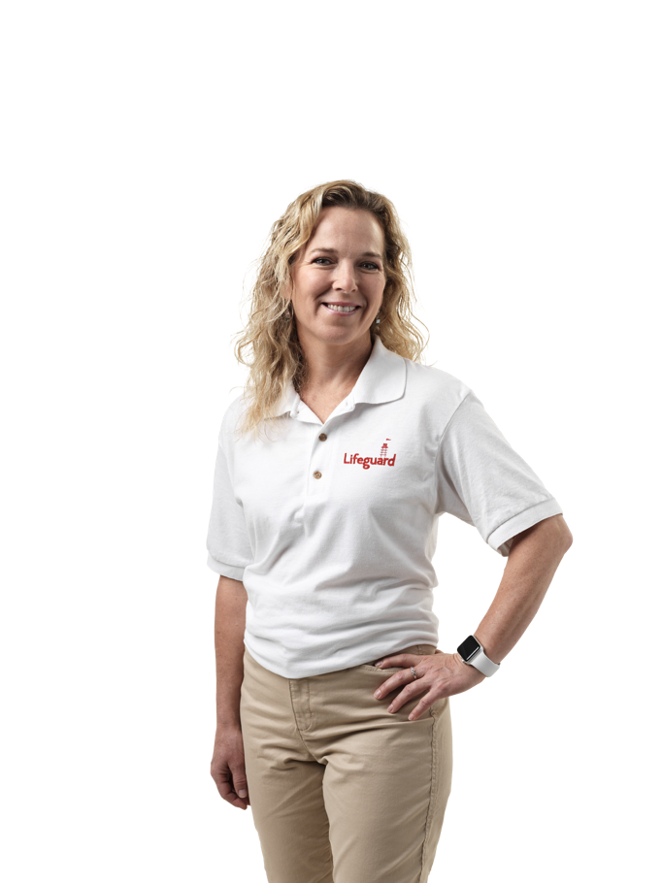
Real World Results
BUSINESS OUTCOMES
PROVEN RESULTS
12% increase in Care Hours Delivered
through earlier identification of changing client needs
More thank 2x Client Retention
compared to clients without Lifeguard monitoring
31% of alerts resulted in a proactive safety check
that otherwise would not have occurred.

Slide 12
Why Partners Choose Lifeguard
BUSINESS OUTCOMES
Griswold Home Care and Lifeguard work together to help identify changes earlier, support timely intervention, and provide additional visibility into client wellbeing between visits.
While no technology can predict or prevent every adverse event, continuous wellness monitoring can help care teams recognize changes sooner and make more informed decisions about support and care
✓ Enhanced oversight between visits
✓ Additional visibility into client wellbeing
✓ Earlier identification of changing care needs
✓ Data-informed conversations with families
✓ A proactive approach to aging in place

Slide 13
THANK YOU

